Slide 1
Docket NO. 22-01-NG Technical Conference
Ben Butterworth
Director: Climate, Energy, & Equity Analysis 02/09/2023

Slide 3
Key Questions
Key questions for informing the “Abandon or Replace” discussion
What assumptions and inputs are critical to the outputs of the Technical Analysis?
What scenarios for (all) sector-level emissions will allow the state to meet the emissions reduction mandates of the Act?

Slide 4
Assumptions & inputs critical to outputs of technical analysis
Five key assumptions/inputs:
Lifecycle GHG emissions of biofuels
Availability of biofuels
Methane leaks from the gas system
Out-of-state emissions associated with production and transmission of fuels
Global warming potential (GWP) of methane
Where high levels of uncertainty exists, sensitivity analysis should be performed

Slide 5
Lifecycle GHG Emissions of Biofuels
Evaluating GHG-reduction potential of biofuels requires lifecycle emissions analysis
However, the RI GHG Inventory currently considers biogenic emissions scope 3, thus not impacting reported state-level emissions
Now is the time to re-think how we approach GHG accounting for biofuels:
RI 50% biodiesel blend in heating oil by 2030 requirement
MA Future of Gas pathways envisioning 60%+ of energy flowing through the gas distribution system to be RNG by 2050

Slide 6
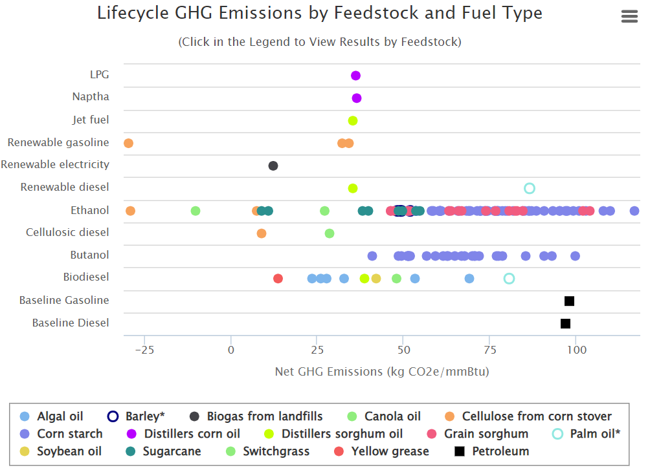
Lifecycle GHG Emissions of Biofuels Cont.
Lifecycle GHG emissions of biofuels vary widely, as EPA’s Renewable Fuel Standard demonstrates
Overwhelming majority of biofuels show positive net GHG emissions, with some exceeding emissions from fossil fuels
Source: https://www.epa.gov/fuels-registration-reporting-and-compliance-help/lifecycle-greenhouse-gas-results

Slide 7
Availability of Biofuels
Combusting biogas where it is created (e.g., WWTP, landfill) is often less GHG intensive on a lifecycle basis than upgrading biogas to RNG, due to methane leaks along RNG supply chain
Biogas CHP serving as dispatchable electricity generation to compliment variable renewable generation will likely be highest value use of biogas in many instances
Producing RNG form intentionally produced methane (e.g., biomass gasification) is not a viable climate solution given methane leaks
True “waste methane” available for RNG production is <1% of current U.S. natural gas demand (Grubert, 2020)
See Dr. Emily Grubert paper: “At scale, renewable natural gas system could be climate intensive: the influence of methane feedstock and leakage rates”

Slide 8
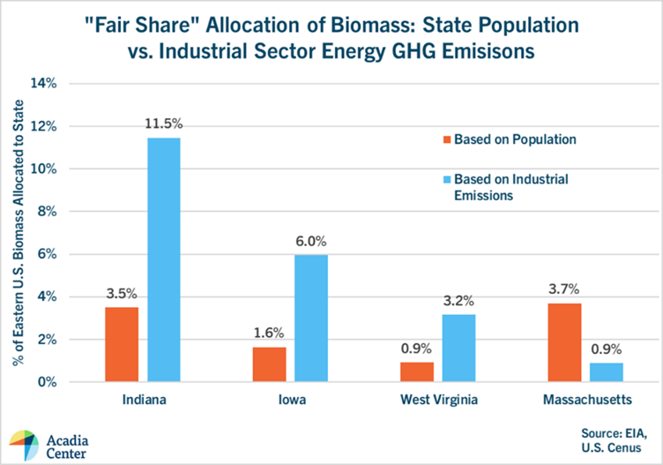
Availability of Biofuels Cont.
On per capita basis, biomass resources in New England are about ¼ that of national average
Thus, determining RI’s fair share of these limited resources is critical
MA 20-80 analysis allocated Eastern U.S. biomass based on state population, rather than relative concentrations of difficult-to-electrify sectors in each state

Slide 9
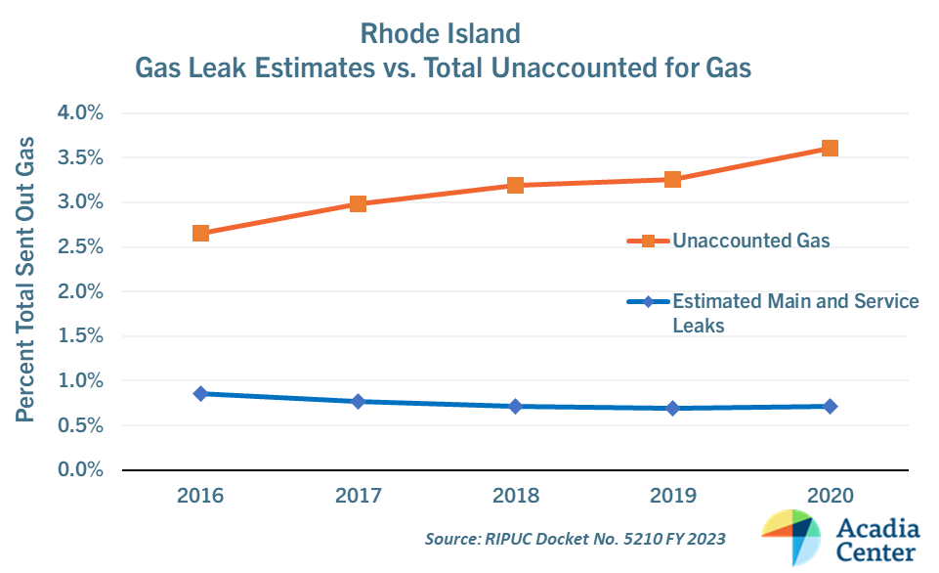
Methane Leaks from Gas Distribution System
Disconnect between levels of unaccounted for gas and estimated main and services leaks captured in RI GHG inventory
In 2020, unaccounted for gas 5.1 x higher than estimated main and service leaks
Methane leak reduction benefit of replacing cast iron and unprotected steel mains unclear
Material | % Change Main Miles: 2016-2020
Cast Iron | -12.6%
Unprotected Steel | -24.0%
Plastic | +15.9%

Slide 10
Methane Leaks from Gas System Cont.
A long-term study by Harvard scientists (Sargent et al., 2021) found 6x more methane leaking into the air in Boston metro than reported in the MA Inventory
Boston metro (28-mile radius) had 4.7% gas leak rate from “well pad to urban consumer”
Using 20-year GWPs, if just 3.0% of gas is lost to atmosphere, GHG impact is equivalent to coal
Study observed no changes to level of methane emissions in Boston area over period of 8 years despite significant efforts to slow the rate of leaks from the gas system

Slide 11
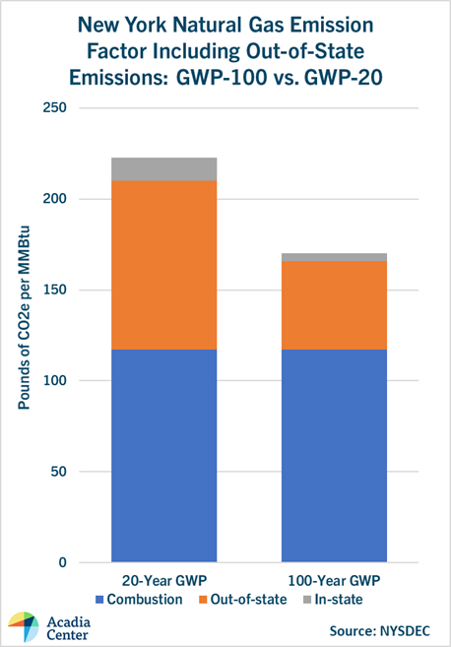
Out-of-state emissions from fuel production & transmission
New York recently updated GHG accounting practices to 1) Include out-of-state fuel extraction + transmission and 2) Use a 2o-year GWP
Together, both changes increased estimated emissions from natural gas 84%
RNG supply chain has been shown to be as, if not more, leak-prone than natural gas supply chain

Slide 12
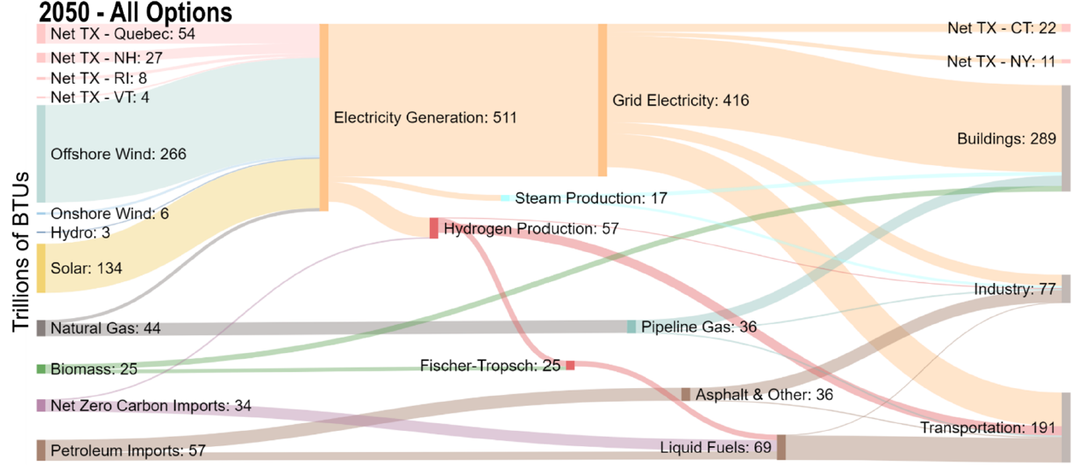
Scenarios: MA 2050 Decarbonization Roadmap Findings
All Options Pathway: “Under the most likely assumptions, what is the least-cost deployment of energy system technologies that achieve deep decarbonization?”
90%+ of all building sector end uses electrified
No hydrogen to building sector
Biomass feedstocks not used to produce pipeline gas
87% reduction in pipeline gas energy compared to 2020

Slide 13
Scenarios: Does Hybrid Heating Have a role?
Hybrid electrification strategies pair heat pumps with a combustion-based back-up heating system
To determine if hybrid heating has a transitional role in Rhode Island’s path towards carbon neutrality, it must be modeled appropriately
Some modeling analyses have favored a hybrid electrification approach to minimize system-wide costs
Why? One reason: If deployed strategically, back-up heating systems can help reduce future peak electric grid demand during winter cold snaps coinciding with periods of low wind + solar production

Slide 14
Scenarios: Does Hybrid Heating Have a role?
However, there are multiple fuels that can serve that back-up role: Gas, heating oil, propane, wood pellets
Gas is the only back-up option that requires an extensive network of leak-prone pipes
Key Research Questions: If economy-wide decarbonization pathways analysis is calling for an ~84% reduction in fuel combustion in buildings by 2050 (e.g., MA Roadmap):
Does it make sense to maintain the gas distribution system to serve this back-up function for a handful of days each year?
Or is it more cost-effective to have this back-up role played by some combination of heating oil, propane, and wood pellet systems?

