Slide 1
Abandon or Replace? DOCKET NO. 22-01-NG Technical Conference The future of the regulated gas distribution business in Rhode Island in light of the Act On Climate
Mackay Miller Partner, ERM
9 February 2023
© Copyright 2023 by The ERM International Group Limited and/or its affiliates (‘ERM’). All Rights Reserved. No part of this work may be reproduced or transmitted in any form or by any means, without prior written permission of ERM.

Slide 2
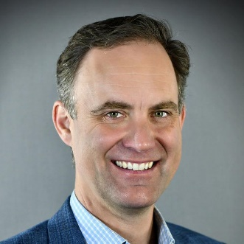
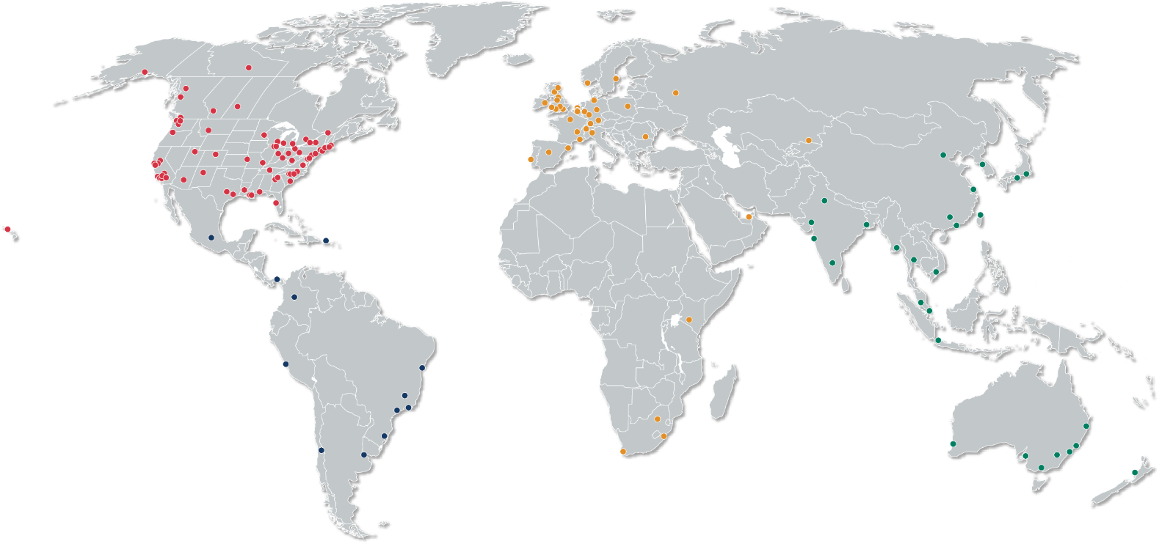
Speaker background
ERM is a technical consulting firm with over 7,000 people in over 40 countries and territories working out of more than 160 offices.
Mackay Miller is a partner at ERM, focusing on developing decarbonization pathways and energy transition strategies for energy, financial, and non-profit clients. From 2015-2022 he was a director of corporate strategy for National Grid US. From 2009-2015 he worked at the US Department of Energy’s National Renewable Energy Laboratory. He holds an MBA from the University of Colorado, Boulder and a Bachelor of International Relations from Brown University. Mackay was a Rhode Island resident from 1997 to 2008.
Mackay.Miller@erm.com
ERM Services include:
Corporate Sustainability and Climate Change
Capital Project Delivery
EHS Management and Compliance
Liability Portfolio Management and Remediation
Safety Services
Operational Performance

Slide 3
Technical Analysis Scoping questions
Questions | ERM view
What infrastructure and non-infrastructure options exist for reducing emissions from the gas system? Which have been explored in previous and current studies and which have not? What updates to the examinations in previous studies, including key assumptions, should be updated and/or considered for sensitivity testing? | The main infrastructure and non-infrastructure options have been explored in previous studies, esp. the 2020 Heating Sector Transformation report for single-family homes. For multi-family and commercial buildings, options are most clearly laid out in the 2021 Carbon Neutral NYC report and in the 2021 Resource Efficient Electrification approach. Updates to these studies should include: Costs: Base year re-baselined to 2022 RI actuals whenever practicable; Forecasts updated to reflect federal tax incentives (e.g. Inflation Reduction Act); Gas price sensitivities including higher volatility; actual costs from Eversource Massachusetts networked geothermal pilot Performance: Metered field data to validate heat pump performance Options that were not explored in previous studies that should be considered include: Multi-family geothermal networks, e.g. Enfield Council Distributed methane leak monitoring (e.g. as an alternative to pipe replacement) Robotic pipe repair, e.g. ARPA-E REPAIR program

Slide 4
Technical Analysis Scoping questions
Questions | ERM view
What scenarios for (all) sector-level emissions will allow the state to meet the emissions reduction mandates of the Act? | Reports that provide scenario frameworks for meeting the Act include: The 2019 Gridworks “California’s Gas System in Transition” study The 2020 Heating Sector Transformation report The 2021 Carbon Neutral NYC report The 2022 Massachusetts DPU 20-80 Independent Consultant Report
What is the appropriate baseline for the economy and for the gas system? In terms of different timing and extent of emissions reductions, what is the implication of these scenarios on the gas system? Does the feasibility of options for reducing gas system emissions change between these differences in timing and extent in these scenarios? | The appropriate baseline for the economy reflects all new federal subsidies in formulating the new business-as-usual forecasts across the main sectors of power, transportation, and buildings. The speed and scale of reduction pathways impact the gas networks in the key areas of network size, leak rate, material composition, labor force requirements, customer economics, property tax payments, and shareholder value. Yes. Feasibility is most acutely impactful in the areas of strategic decommissioning, customer economics, RNG supply, and electricity supply and delivery.

Slide 5
Technical Analysis Scoping questions
Questions | ERM view
What assumptions and inputs are critical to the outputs of the Technical Analysis? | Key assumptions and inputs include: EE and heat pump cost and performance (annual and peak) across the Rhode Island building taxonomy RNG and H2 cost and deliverability for all hours of the year Natural gas cost volatility Carbon-free electricity cost and performance (esp. winter peak coincidence) Current and forecast cost of pipe repair and replacement Pipe leak rate forecasts by material and location
Does current knowledge about these assumptions warrant testing alternative assumptions? Does current knowledge about these inputs warrant performing sensitivity analyses? | Yes. Enough is known about each of these to justify testing alternative assumptions. (b) Yes. Enough is known about each of these to justify sensitivity analyses.

Slide 6
Technical Analysis Scoping questions
Questions | ERM view
What mechanisms could be created that would enable decreased emissions from the gas system consistent with the Act? | Rhode Island’s emissions goals will benefit from a coordinated suite of mechanisms that ensure equitable access to high-quality energy, practical solutions that can scale rapidly, and appropriate incentives for utility investment. An example of such a coordinated suite enactable by the PUC would include: Definition of Comparable Substitute Service (CSS) that clarifies the minimum threshold of performance benchmarked against the cost, convenience, and reliability of gas. Development of a Unified Benefit-Cost Analysis (BCA) framework for network planning that ensures that RIE is transparently evaluating electric, gas, and building options for Comparable Substitute Service. Require leak-prone pipe segment suitability scoring that ensures that RIE is regularly and transparently evaluating pending network replacement segments for Comparable Substitute Service solutions using the using the Unified BCA framework. Require the provision of public information tools (e.g. geospatial maps) that present Unified BCA results and leak-prone pipe segment suitability scores to enable zero-carbon project development and stakeholder engagement. The establishment of such a suite would be foundational for the specific actions at issue in this proceeding, e.g.: moratoria, alternative ratemaking, approval of recovery for alternative technologies, changes to depreciation schedules, and network abandonment.

Slide 7
Thank you
Mackay Miller
Partner
Mackay.Miller@erm.com
+1 774 893 1877
Boston, MA

