Slide 1
Advanced Meter Functionality
RI Public Utility Commission Technical Session
May 10, 2023

Slide 2
Agenda
PPL’s history with Landis+Gyr (L+G)
PPL’s Landis+Gyr Synergies for RIE
Status of AMF key agreements, proposals and RFP’s
AMF components, solutions and roles
Rhode Island Energy AMF advantages over PPL PA and KY
Approach to validating proposed costs
Implementation cost review with resourcing/provider
AMF spend to date
Summary take-aways
Q&A

Slide 3
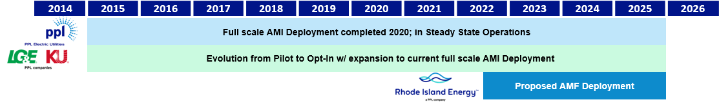
PPL’s History with Landis+Gyr
PPL Pennsylvania and PPL Kentucky’s AMI relationship with Landis+Gyr initiated 2014-2015.
PPL Pennsylvania and PPL Kentucky have and are using Landis+Gyr for AMI Systems, Network, and Hardware.
AMF Category |  | PPL PA | PPL KY | RIE Proposed
Systems | Head End | X | X | X
 | MDMS | X |  | X
 | DER Monitor & Manage | X | TBD | TBD
Network | Hardware | X | X | X
 | Installation Services | X |  | X
 | Optimization Services | X | X | X
 | Steady State Field Network Equipment Maintenance | X | TBD | TBD
Meters | Hardware | X | X | X
 | Installation Services | X | X

Slide 4
PPL’s Key Landis+Gyr Synergies for Rhode Island
Leverage the existing PPL Services AMI Systems Operations department that is trained, skilled and knowledgeable with the Landis+Gyr platform and meters. This will save costs during implementation and steady state operations, eliminating the need to stand-up a new group with new processes (driven from a different AMF solution) specifically for RIE.
Leverage the existing PPL Services Network department that is trained, skilled, and knowledgeable with the Landis+Gyr radio frequency network and Landis+Gyr platform. This will save costs during implementation, optimization, and steady state operations, eliminating the need to stand-up a new group with new processes (driven from a different AMF solution) specifically for RIE.
PPL Information Technology can leverage the existing technical architecture, integrations, system processes, and experiences specific to the Landis+Gyr technology stack, reducing implementation risk and enabling cost efficiencies for both implementation and ongoing steady state operations.
Implementation risk reduction driven from prior experience and knowledge in the full-scale installation of the Landis+Gyr AMF technology solution. PPL PA delivered on schedule and on budget with all targeted scope completed.

Slide 5
PPL’s Key Landis+Gyr Synergies for Rhode Island Cont’d
Leverage the existing PPL meter technology setup specific to Landis+Gyr for meter asset management, meter test operations, and meter engineering. Meter asset management, and meter test operation, and meter engineering are being provided under TSA Exit.
Leverage and scale existing PA and KY AMF implementation and steady state business processes specific to the Landis+Gyr technology, making the necessary RIE specific adjustments. Examples include the forms, documents, and procedures for deployment, and functionalities like remote connect and disconnect of service, proactive outage management, and meter alerts for both implementation and steady state operations.
Long-term efficiencies aligning RIE with PA and KY AMF for PPL standardization and consistency.
Overall, not using the Landis+Gyr technology solution increases costs and risks associated with a new unfamiliar AMF solution.

Slide 6
Status Outline on Landis+Gyr Agreements and Proposals
Landis+Gyr software delivery and SaaS Agreement
  Final agreement will include PPL enterprise terms and conditions, along with a Rhode Island Energy specific delivery statement of work, and service order pricing.
  Covers both Transition Services Agreement (TSA) Exit and AMF functionalities.
  The meter data management system (MDMS) covers both non-AMF (TSA Exit) and proposed AMF terms, scope and pricing.
    TSA Exit functionality includes retail settlement, load profiling, and storing of meter data from the electric and gas commercial and residential meter reading systems.
    AMF pricing includes the shifting of electric AMR to electric AMF data.
    PPL’s architecture includes existing code scheme for MDMS.
  The head-end system, along with Wi-SUN functionality, is included in pricing for AMF only.
  Grid Analytics, which is a small component of the overall cost, is also included in pricing for AMF only.
  The following are key contingencies for AMF functionality and pricing:
    Regulatory approval, including any modifications to RIE’s proposed plan.
    Successful installation of the new AMF meters.
  Cost compare of completed PA actuals to RIE proposed.
Landis+Gyr meter and network hardware equipment proposal
  Includes meter and network equipment costs by specific equipment type.
  Proposing to include network installation and optimization services.
  Landis+Gyr is the preferred provider, based on cost reviews, driven by PPL synergies and subject matter expertise.
  Contract discussions are in progress for separate contract.

Slide 7
Status Outline on Pending AMF Request for Proposals
Meter Installation Services
  Includes meter installations and associated project management, pre-sweeps, meter base repairs, call center operations, and inventory and warehouse management.
  RFP process has been completed and vendor selection is underway.
  Stand-alone contract will be needed for terms and conditions, statement of work, and pricing.
Project Management Office Services
  RFP is in progress for external resourcing.
  Stand-alone contract will ne needed for terms and conditions, statement of work, and pricing.

Slide 8



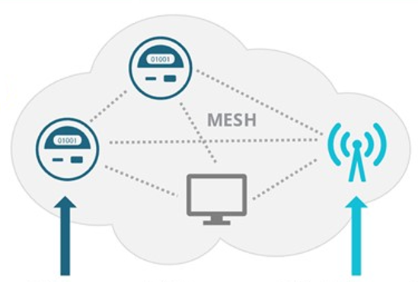








AMF Components, Solutions and Project Roles
Customer
Systems
Metering Systems/
IT Platform
Two Way
Communication Network
AMF Meters
HES
MESH
HAN
Customer Service System (CSS) and
Customer Portal
AMF Head End System
Meter Data Management System (MDMS)
Network Backhaul
Radio Frequency
Mesh Network
AMF Meters
Behind the Meter Devices
 | PPL IT | L+G Cloud-Based SaaS | Cellular Service | L+G RF Mesh | L+G Revelo Meter | Behind the Meter: Revelo-enabled
Ownership | PPL Services | PPL Services | Third Party | Rhode Island Energy | Rhode Island Energy | PPL/RIE/TBD
Installation | PPL Services/System Integrator | Landis+Gyr/System Integrator | Third Party | Landis+Gyr | RIE/Meter Install Vendor | PPL/RIE/TBD
Project Oversight | PPL Services | PPL Services | PPL Services | PPL Services | RIE/PPL Services | RIE/PPL Services
Steady-State Operations | PPL Services | Landis+Gyr | Third Party | TBD/Landis+Gyr | RIE/PPL Services | PPL/RIE/TBD

Slide 9



Recent AMF Evolution Parallels Telephone Evolution
Technology evolution for Telephones parallel that for Metering where each have advanced due to improved connectivity, storage, computing and sensing.
The evolution of telephone technology
The recent evolution of metering technology
AMR
AMI 1.0
AMI 2.0
RIE Current
PPL PA
and PPL KY
RIE
Proposed

Slide 10
RIE AMF Advantages over PPL PA and PPL KY
Operational Advantages:
Network is 4X faster / greater capacity which allows for near real-time processing - accommodates 15-minute interval data processed every 15-20 minutes (vs every 4-6 hours in PA).
Wi-SUN on the RF network provides interoperability, broadening opportunity for others to participate.
Enhanced phase and grid anomaly detection is aided by millisecond resolution network time.
Higher resolution and more frequent voltage measurements allow operators to better regulate and optimize grid voltage.
Better DER / EV integration with higher resolution current and voltage streaming and better harmonic measurement capability.
Future meter firmware and data enhancements are possible with more CPU RAM and faster CPU speeds.
App-ready meters offer the potential for new service offerings to benefit the grid.
Customer Advantages:
Improved awareness of usage at the device level in real-time provides an understanding of impact on consumption from behavior adjustments.
Meters with Wi-Fi can be paired with apps to provide a variety of new services: meters could analyze device-level energy and instruct large loads like an EV chargers to engage when rates are low, making TVR more feasible.
Providing added comfort when away because non-intrusive load monitoring offers an understanding of when various appliances are running.
Meter software makes it possible to offer home energy management that can integrate with smart home devices such as Amazon Alexa or Google Home.
High-quality energy data can provide an understanding of electrical panel issues and where upgrades are needed.
Easier decisions on using DER energy versus selling it are possible from enhanced forward and reverse energy register information and added channels.

Slide 11
Approach Used for Cost Estimation
PPL KY Compares
PPL PA Compares
National Grid AMF Filing with BCA Costs
Estimated and Validated Cost
Scope:
RIE AMF Requirements
RIE Assets, Organization, and Territory
AMF cost not to exceed those proposed in National Grid Docket No. 5113
Vendor proposals, RFPs, and agreements

Slide 12

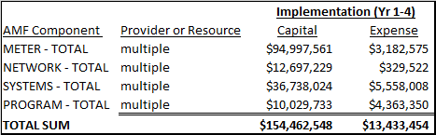
Overview Costs – Implementation
Note: Amounts may not add exactly due to rounding
Highlights:
Total Implementation cost estimate is $167,896,002, slightly less than National Grid’s filing (Docket No. 5113).
PPL vendor cost estimates are from 2022 compared to National Grid’s primarily 2018; Core CPI increased approximately 13+% from start of 2019 through mid-2022.
RIE is proposing the same Landis+Gyr AMF technology solution that National Grid initially proposed for Rhode Island and is deploying in New York and recently approved in Massachusetts.

Slide 13
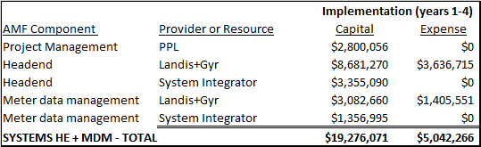
Systems Costs – Headend & MDM – Implementation
Note: Amounts may not add exactly due to rounding
Highlights:
Cost compare completed against PPL PA total on premise to proposed cloud solution; yielded comparable costs using meter end points equalizing.
RIE enhancements compared to PPL PA:
  RIE proposed solution will enable faster interval processing: PA every 4-6 hours compared to RIE near real-time every 15-20 minutes.
  RIE would have a fully integrated disaster recovery solution.

Slide 14
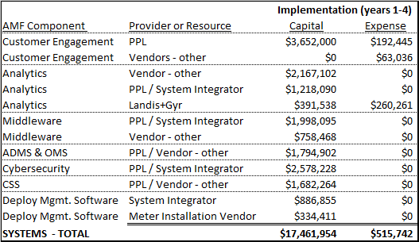
Systems Costs – multiple – Implementation Cont’d
Note: Amounts may not add exactly due to rounding

Slide 15
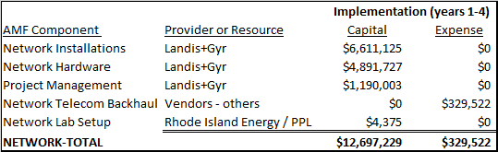
Network Costs – Implementation
Note: Amounts may not add exactly due to rounding
Highlights:
Radio frequency (RF) network design completed to correctly size and cost estimate; includes near real time specification for 15-minute intervals every 15-20 minutes.
Reduce implementation risk using Landis+Gyr as the provider responsible for installation and optimization of their Network technology via a milestone delivery approach.
Overall total weighted average network hardware unit price is approximately 47% less than National Grid’s in Docket No. 5113 BCA.
Project Management is specific to vendor oversight of network installations; PPL oversees both activities.

Slide 16
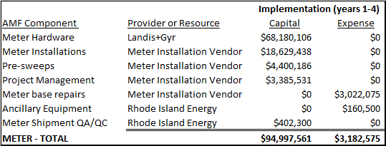
Meter Costs – Implementation
Note: Amounts may not add exactly due to rounding
Highlights:
RIE overall total weighted average meter unit price is slightly higher, +1.7%, than National Grid’s total meter unit price in Docket No. 5113 confidential BCA.
Project Management is specific to vendor oversight of meter installations; PPL oversees both activities.

Slide 17

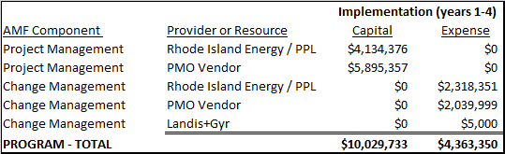
Program Costs – Implementation
Note: Amounts may not add exactly due to rounding
Highlights:
PMO Vendor RFP is in progress.
BCA Estimates were based on PA experience on resources and skills needed for implementation coupled with industry hourly rate estimates.

Slide 18
AMF Costs Incurred to April 30, 2023
Highlights:
Project timeline anticipated project costs ‘at-risk’ for work to be completed prior to an anticipated ruling.
Referring to the testimony of Walnock & Reder, Bates 46 of 84, states: “The Company will be performing work associated with Systems, Meters, RF Network Equipment and Planning functions totaling approximately $8 million prior to receipt of regulatory approval for the AMF Business Case.”
The handling of these costs have been contemplated, as outlined in the cost recovery section of the business case, in the event AMF is not regulatory approved.

Slide 19
Summary Take-Aways
PPL has a successful history with Landis+Gyr established through prior AMI deployments. Extending the relationship to Rhode Island provides efficiency synergies, reduces implementation risk and offers increased project certainty.
The Rhode Island AMF Business Case components have been fully vetted and reviewed for a best value approach; founded on proposals, RFPs, and agreements that are in process.
Rhode Island Energy is receiving the next wave of AMF technology that leapfrogs capability in PPL PA and KY offering potential to unleash new benefits and services with continued scale potential.
Proposed AMF 2.0 components include solutions provided by Landis+Gyr and others that will be owned by PPL/RIE, installed by 3rd parties and Landis+Gyr with PPL/RIE oversight and ultimately operated by PPL/RIE and Landis+Gyr.
Landis+Gyr proposed costs are competitive, especially given the impacts of inflation.

